Slide 1
New Netherland and beyond: Path to Slavery 1624-1870
Dutch Pirates Bring Slavery in 1624
Baptisms, Marriages, Burials, Diaries
States General Charters Dutch West India Company
The Patroon System, Hudson Valley
Michaelius Ousted, Never to Return
Hondius, Udemans, and Kay Equivocate
Colonial Orphan Churches Must Improvise 1628-64
Age of Abolitionist Rhetoric: Mine Eyes Have Seen
New Netherland Governors: and their Remonstrants
Kieft’s War Brings New SELF GOVERNANCE
Hero: Adrian Vander Donck 1641-1656 a Calvinist Christian Man
Classis of Albany, Seed of the American Reformed Church : 1762
Struggles for Civil Rights, Flushing Remonstrance to End of Civil War

Slide 2
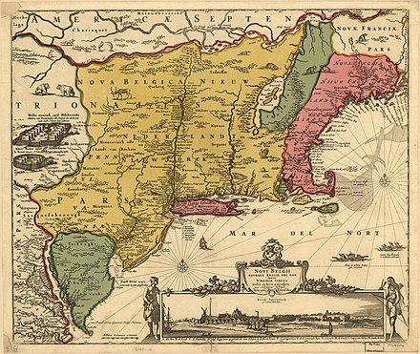
Early Map of New Netherland
This Photo by Unknown Author is licensed under CC BY-SA
This Photo by Unknown Author is licensed under CC BY-SA

Slide 3
Wall Street Keeps out who? Invaders? Indians? British soldiers? New Englanders?
This Photo by Unknown Author is licensed under CC BY-SA

Slide 4
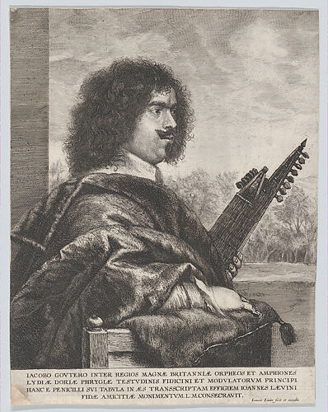
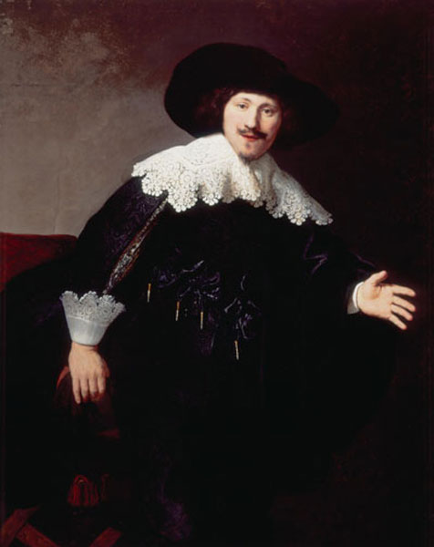
Calling All Farmers, Make a Deal with VRW
Who wants to pay rent to Van Rensselaer?
VR and VOC add 12 slaves to the offer, VR is a Diamond and pearl merchant get criticized from both sides – VOC and his tenants
Many get to Manhattan and skip the patroon idea at R-Wyck, safe near the Fort and behind the wall of Wall Street.
This Photo by Unknown Author is licensed under CC BY-NC
This Photo by Unknown Author is licensed under CC BY-NC

Slide 5
Fort Orange, walled and developed.
This Photo by Unknown Author is licensed under CC BY-SA-NC

Slide 6
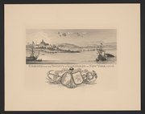
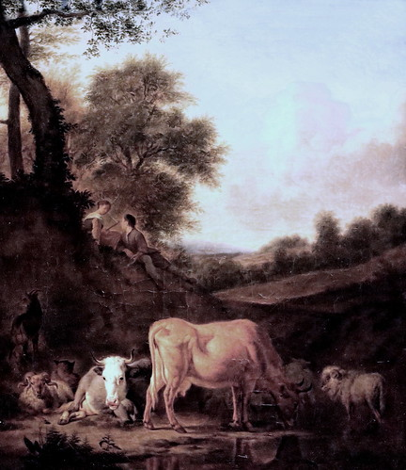
Come to an Edenic scene ?
This Photo by Unknown Author is licensed under CC BY-SA
This Photo by Unknown Author is licensed under CC BY-SA
This Photo by Unknown Author is licensed under CC BY-SA-NC

Slide 7
Island at the Center of the World, as in 1619 to Stuyvesant’s surrender to English in 1664
Described by Russell Shorto, not exactly the new Garden of Eden, but the Island at the center of the world’s future in North America as it meets the European past and present world of the 1640s.
Adrian Vander Donck was a landowner who employed tenant farmers, not slaves, and who treated Indians with fairness and insight.
The actual colony (Shorto version) is not Eden but is an origin story that is full of characters who were allied, or members of the Dutch Reformed (and English Reformed and French Reformed) people who played their parts in shaping the colony through the rest of its life as a Dutch settlement – a society, not just a trading post.

Slide 8
Reformed Oude Kirk in Amsterdam
This Photo by Unknown Author is licensed under CC BY-NC

Slide 9
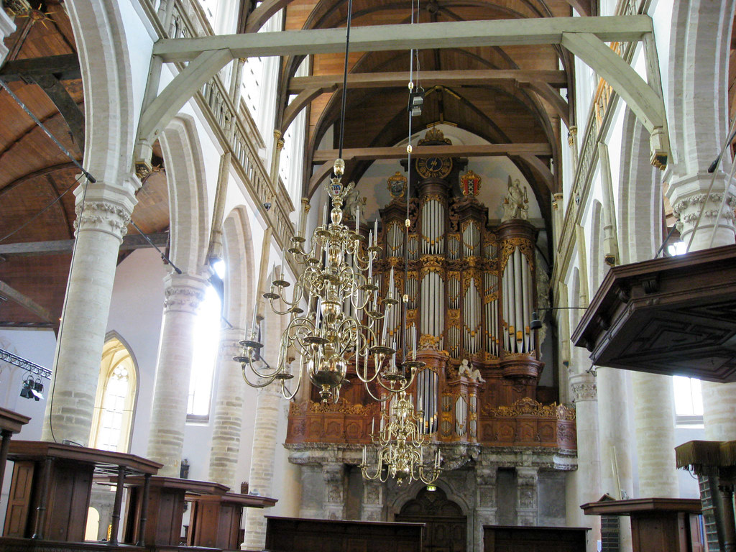
Stately, but a state church?
This Photo by Unknown Author is licensed under CC BY-NC-ND
This Photo by Unknown Author is licensed under CC BY-NC-ND

Slide 10
Dutch East India Company HQ, Amsterdam and other cities have offices

Slide 11
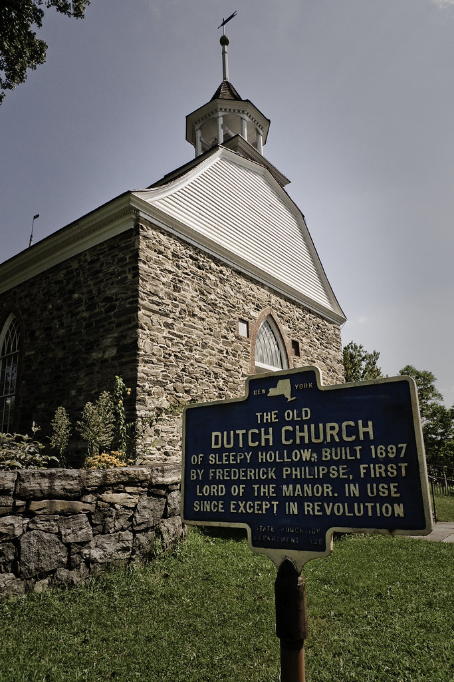
Simple yet settled
New Paltz was founded by French
Huguenots, and Walloons
And many of the names are German
And built by its members
Not Dutch West India Company
Not the States General
Not the Dutch Reformed Church
Classis of Amsterdam…..
Same goes for Sleepy Hollow church
by its patroon Frederick Phillipse
This Photo by Unknown Author is licensed under CC BY-SA-NC

Slide 12
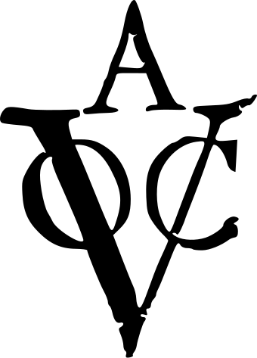
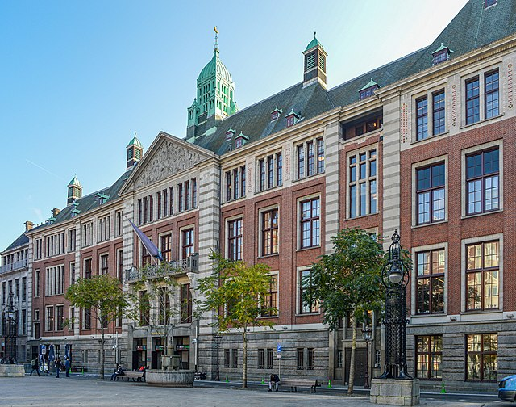
Company rules to 1796 bankrupt:

Slide 13
Bowne House, Queens, New York, Remonstrants Gather with Vander Donck, Francis Doughty
This Photo by Unknown Author is licensed under CC BY-NC-ND

Slide 14
The downfall of Stuyvesant, penned first by Adrian Vander Donck, d. 1656.
. Elders, other citizens and pastors like Doughty (Vander Donck’s father in law) in churches of Long Island, Presbyterian and Reformed, join to make a strong, angry appeal about deprivation of civil rights.
Objections to slavery are bitter, and include failure of VOC to send competent schoolmasters or make any efforts with blacks, or Indians, or the settlers’ own children, in instruction.
Flushing Remonstrance is a key civil rights outcry to Dutch lords, son behalf of angry, righteous citizens, coached by Vander Donck.
Vander Donck had a long and useful relationship to Megapolensis, who served 22 years of the 87 “pastor years” of DRC clergy, 1628, in close friendship and cooperation as both studied the Indians.

Slide 15
Reformed Elders and Laity Guide Orphan churches who arise and grow without clergy.
Across Europe, mid 1600s, middle class people seized literacy, especially Protestants.
Leiden Univ dedicated in 1570s
Telescopes, astronomy, biology , maps and navigation, cartography. Dutch science takes huge strides. Common people can attain ed. equivalent to H.S.
Netherlands had highest literacy rates in Europe (85% in 1701). This would reflect in church membership.
Common books laity had in home:
. Foxe’s Boke of Martyrs
. The Pilgrim’s Progress
. Vander Donck’s Description
. Almanacs
. For educated people, folk tales
. Meditations, Sermons, Hymns
. Genevan Psalter (of 126 hymns)
Heidelberg Catechism, Belgic Confession for Reformed churches

Slide 16
Schools of the New Netherlands/ New York
Population of NN rose to about about 3,000 in under 20 years in NN y 1643.
. The VOC failed by 1796 but schools rooted in early years continued.
Northern “runaways” disappear in place.. Some form secret Sunday schools, in NYC/s large black pop.
Masons, carpenters, builders, etc. arise in Northern states after 1780
Literate slaves existed, including among clergy, other than Capitein.
Routes lead to NYC by 1839 FD
This Photo by Unknown Author is licensed under CC BY-SA-NC

Slide 17
By 1850, 3rd generation
As soon as the slaves had lived among English speaking people e second and third generations (20-40 years) could attend a church service. Some had been churched since 1600s. As slaves who spoke Dutch from birth joined churches, some remained RCA, formed in 1700s.
Douglass meets a network of free blacks who help him after escape, in religion. David Ruggles.
Remarkable entries into the early records of the Dutch churches. Beginnings of black preachers
This Photo by Unknown Author is licensed under CC BY-NC-ND

Slide 18
Reformed Polity Fits Free People, Diverse?
Marriage not a sacrament for Protestants. It is civil law, not ecclesiastical.
Black from the beginning, even if still NY or NJ slaves before 1828, do have votes in congregational matters, Livingston specifies blacks are to be equally honored and recorded in the church as any marriage, baptism or funeral.
Not true that Reformed Churches in 1664, had formed to ban Catholics. Clergy/elder discretion Discretion: The ocean is wide and the Classis of Amsterdam is far away. And by the late 1700s they had a classis in America; goodbye, C of A. No new conversion or re-baptism needed to come in.
The (simple?) Heidelberg Catechism covers: Apostles’ Creed, 10 Commandments, 2 sacraments (baptism and communion), Lord’s Prayer Religion is of the heart. Scorn hypocrisy. The 126 answers say little/nothing about hell. Presumes the children are in Christian homes and do not need a conversion, no need to “Preach hellfire.” Treated as growing in faith – not a “come to Jesus” altar call.
In early 1800s South, see FD’s description of how slaveholders teach the Lord’s Prayer; how slaveholders send fat clergy down to quarters and do soapbox messages on obedience; how Sunday school crushed..

Slide 19
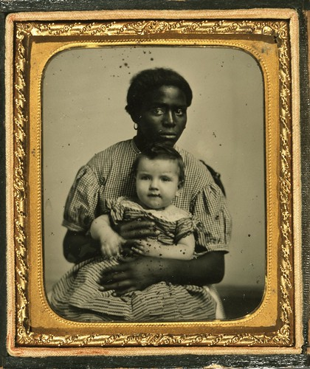
What is so hard about the Heidelberg??
Q: How long does it take to say the alphabet, then count to ten?
A: 30 seconds. One can also recite Apostles’ Creed in 30”
The Lord’s Prayer= 13 seconds .
Rote Memory work is no good unless explained, but children do learn concepts with a teacher.
Nothing is wrong with teaching children a bit over their heads. Catechisms suggest common words to do that – at home or church!
Explains 5 essentials of the faith:
Apostles’ Creed : trinity (30 sec.)
Explained phrase by phrase, for kids
2 Sacraments: baptism, communion
10 commandments
Lord’s Prayer
This Photo by Unknown Author is licensed under CC BY-NC-ND

Slide 20
A Few Blacks by 1640-1780s are free, in RCA long before freedoms came South
Cotton Mather’s slave can read.
Name Onesimus is ambiguous, as St. Paul told master to treat O. as St. Paul
. Mather said masters obliged to educate slaves
True love: is of the soul, “love is eternal” A biblical idea
Phyllis Wheatley was freed by her owners -- poet
Hymnals = references to liberty and justice of God
Votum is an equalizer,
Amsterdam had free blacks by 1650
After elimination of foreign slave trade, the3 slaves brought to auctions were mostly English speaking, NOT brought from Africa. Why did Southern owners OK exing the foreign trade. Keeps $ higher..
A. high bar, can be met by some if they were English or Dutch speaking from birth.Sojourner Truth. Mrs. Auld.
This Photo by Unknown Author is licensed under CC BY-SA

Slide 21
If Music Be the Food of Love… play on
Bach, Buxtehude, and other organists were not, contrary to God’s worship plan. Dutch organs of the 1600s are 1700s are still sought in England, France, Germany and Holland.
Genevan Psalter, introduced by Calvin, with his beautiful introduction. Its 126 melodies and rhymed verses today still turn up in hymnals of Lutheran, Presbyterian, English puritan, and hymns stir very deep feelings, not just ”didactic” material. Hymns travel easily, “by heart.”
Calvin says so. How could a church grounded in that psalter be accused of having no emotions?. The charge that Calvinism is dry and only Baptists show feelings is bogus.
A structure of ”call and response” is a staple of Jewish scriptures: it could not be more ancient. Parallel is the Bay Psalm Book in New England also depends on hymns.
. Hymnals become cheap. Elders on their own for leadership can do it, with a “vorsanger” to lead the people. Skilled reader, reading a sermon from a book of approved sermons is not always bad, if the elders chose good sermons!l And someone musical plans the music. Don’t knock it.
. Who proved that a book of sermons can’t be high quality?
. With Reformed polity empowering laity and, the Genevan Psalter, and the high bar for a sermon, this church was made for the wilderness, even without clergy. Especially when most congregations include literate/musical people with church experience. Its marriage liturgy language was deathless and has lasted to this day, unless you watch the Hallmark channel too much. Same for baptism.

Slide 22
1850: Huckleberry Finn meets Calvin:
“Chaucer is gone. Shakespeare is dead. And I’m not feeling so well myself. “
Mark Twain has Huckleberry Finn ponder what he’s heard from Miz Watson, which is something he doesn’t quite get but calls “preforeordestination”
This Photo by Unknown Author is licensed under CC BY-SA

Slide 23
Abolitionists satirize and dramatize man’s ”fall”
“black comedy” survives in 20th century in Cosby, and many today. Satire and comedy give resonance .
Frederick Douglass used comic scenes and biblical material to great advantage in doing speeches:
Thomas Auld’s Methodist conversion, mockery. Plantation preachers on the soapbox. .
As original sin is hypocrisy, bringing punishment, evasions and excuses give abolitionists power.
Mrs. Auld reading the book of Job opening, as the first time Freddie realized what reading is and asked her to teach him how.
Not Mrs. Aiuld’s idea.. The Promethean idea from the Bible and classic mythology feed into abolitionist rhetoric.
“Letter to. His Old Master” Thomas Auld, who is one candidaite for having been his real father.

Slide 24
Looking Ahead: to a New Jersey House, 1795 when slaves may dwell here as P.O. opened
Side view of a 1795 Federal style house in New Jersey. Slavery was still legal in stages, as young slaves serve temporary indenture.
Because its layout suggests this house could be home to slaves or servants, blacks could leave rural farms. Attic and cellar ARE BOTH amazing places..
Is this hypocrisy? Or escalator,/ accommodation. Which is better, isolated shack in the woods, or share a city house for some in tavern, post office, shop, etc.
In NJ, blacks were the key laborers in the publishing, printing industry. Tiny black fingers could set the letters in place. IN NY and NJ slavery ended by state law, no war.

Slide 25
In NY and NJ slaves lived in-house. Our NJ house was also P.O.
. Amazing basement like an old European wine cellar with light, and stone walls, cool in summer, warmed by its own hearth in winter, and attic also was suitable for a separate “QUARTERS” in winter, cool cellar in summer? Below was the P.O. when there were only 900 post offices in the nation.. Sojourner Truth’s childhood was in cellar of a tavern that was similar to this when Charles Hardenberg owned her parents, near New Paltz. ….
A block away is the Dutch Reformed Church formed in 1766, current bldg from about 1820.
In this area, homeowners may have suffered a stigma to own slaves in 1795 b/c NJ had already slated a phase out. John and I bought this in 2007 - 2017, when I moved to Holland. It is on the Washington-Rochambeau route. Somerset Courthouse, was behind this bldg. burned by the Brits b/c of patriots in Millstone. History is not as old as we think it is.

Slide 26
A republic. Right to redress grievances via an Attorney General Vander Donck. RCA laity and clergy overturn governors protect rights, and GS votes to support Lincoln by 66% in 1861.
Slavery Not Wrong, published by an NBTS prof during abolitionist struggle, merely repeats all the nice arguments of Capitein, and, is vehemently opposed by and elder, who IS ALLOWED TO argue otherwise.
Midwestern volunteers are spirited and Holland, as well as other Dutch communities fervently comply with call for troops in Civil War. Isaac Cappon makes millions of Union boots, many sons face Confederate lines. Lincoln’s Second Inaugural is framed in a Calvinist understanding of the 750,000 lives given for the cause.
This Photo by Unknown Author is licensed under CC BY-NC

